Slide 1
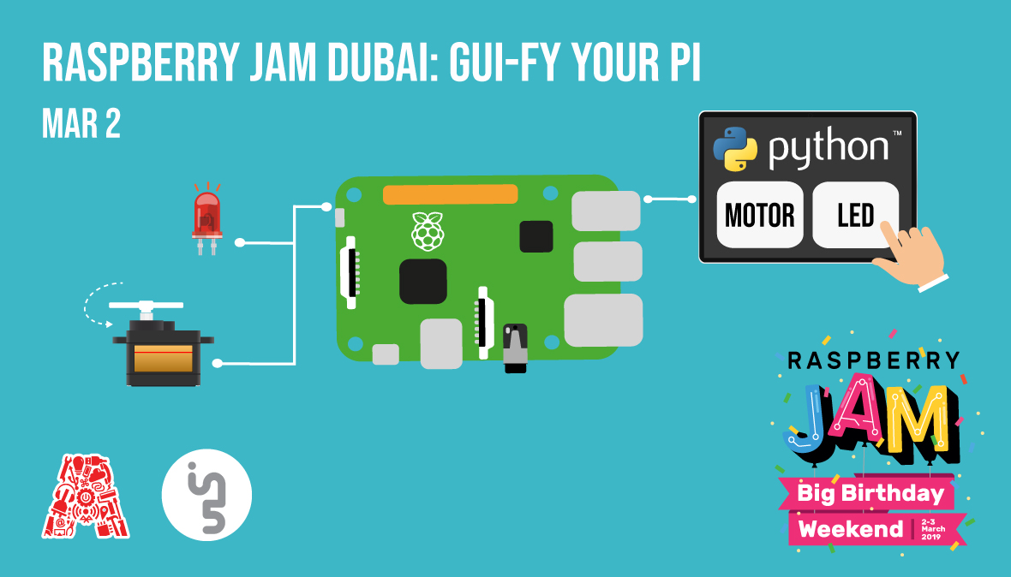

Slide 2
About the Assembly
A smart lab based out of In5 since Dec 2014
Over 200 free workshops done
ASSEMBLY: HACK - Embedded systems, iOT and hardware
ASSEMBLY: CODE - Software projects - APIs, frameworks, apps
Age range: 16-60 - students, professionals, entrepreneurs
Focus on smart technology and practical applications
Forum: members.theassembly.ae

Slide 3
TAG US ON OUR SOCIAL MEDIA
FACEBOOK
TWITTER
INSTAGRAM
YOUTUBE
The Assembly (@MakeSmartThings)
@MakeSmartThings
@MakeSmartThings
The Assembly

Slide 4


Slide 5
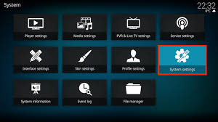
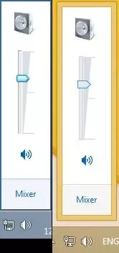
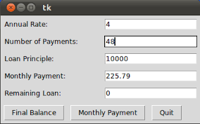
What is GUI?

Slide 6
Benefits Of GUI
Person can use software without programming knowledge
User friendly and simple to use
Easy display of information

Slide 7
Workshop Plan
GUI Design – Buttons, Text & Widget
Connecting Electronics
Back-End Programming
Challenge

Slide 8
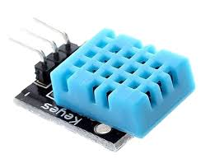
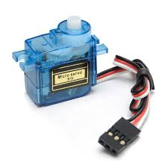
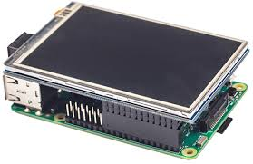
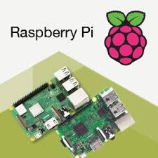
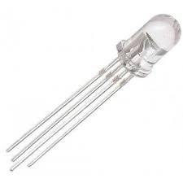
Components we will be using

Slide 9
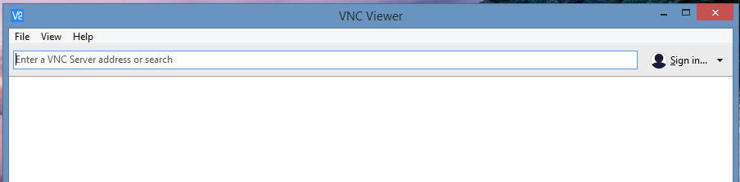
Using VNC Viewer
Step 1:- Download VNC Viewer on this link https://www.realvnc.com/en/connect/download/viewer/
Step2:- fill the IP address of the controlled pc

Slide 10
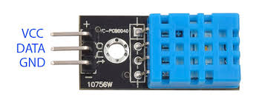
Humidity Sensor

Slide 11
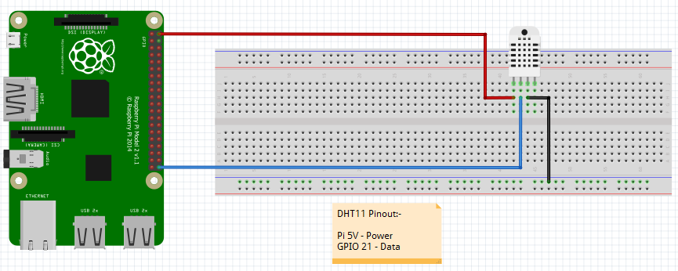
DHT 11 Connection

Slide 12
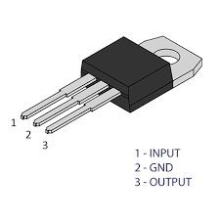
5V Voltage Regulator
Reducing the incoming voltage to 5V
Useful to supply power to low voltage device like Servo Motor

Slide 13
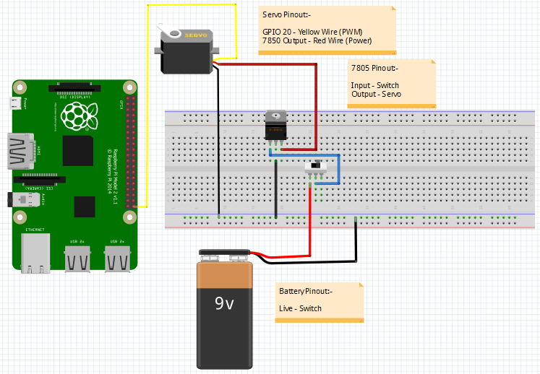
Servo Connection

Slide 14
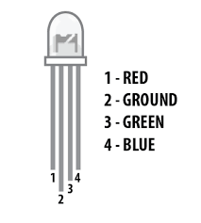
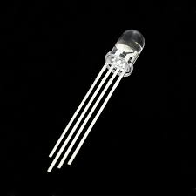
RGB LED Light
Multiple colors can be shown

Slide 15
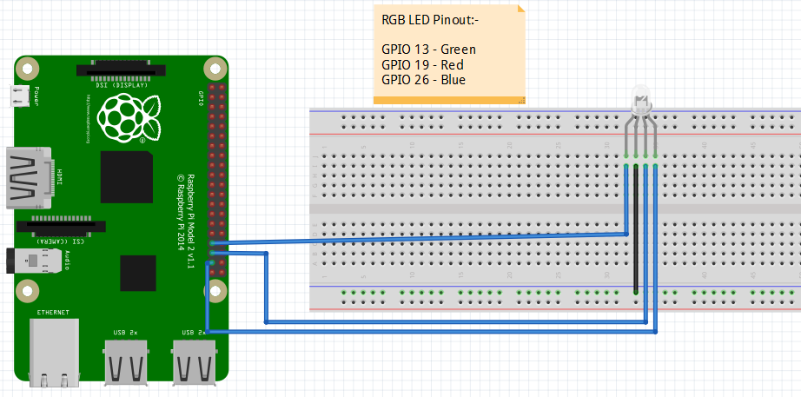
RGB LED Connection

Slide 16
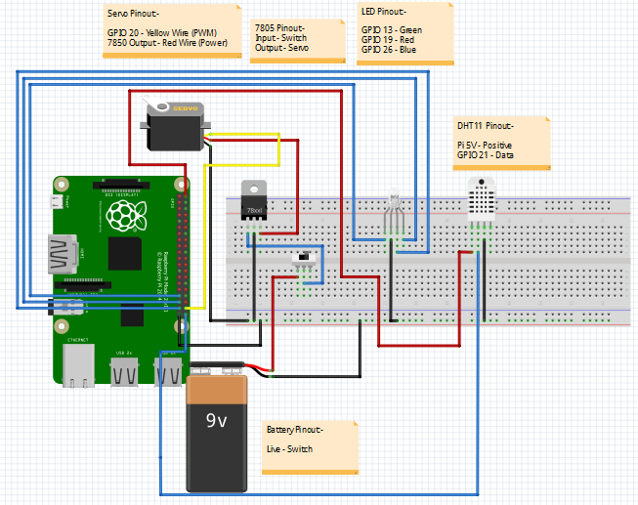
Full Connections

Slide 17
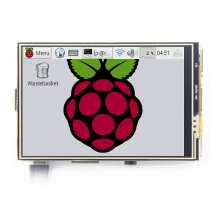
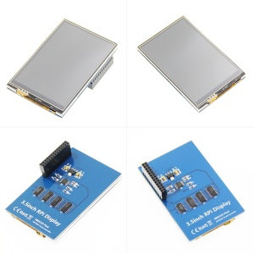
3.5 inch LCD Screen

Slide 18
LCD Screen Setup
Step 1: Connect your Raspberry Pi to a PC monitor, also connect the 3.5 inch LCD to Pi.
Step 2: Turn on the pi and make sure its connected to the Internet via WiFi or LAN.
Step 3: Open terminal in Raspbian desktop, and type the following commands.
cd LCD-show-master/
sudo ./LCD35-show

Slide 19
To Disable LCD Screen Setting
Type the following on Terminal:-
cd LCD-show-master/
sudo ./LCD-hdmi

